Slide 1



WALMART WEEKLY SALES FORECASTING

Slide 2


📑 Table of Contents
DATASET OVERVIEW
TIME SERIES ANALYSIS
HOLT-WINTERS
ARIMA, SARIMA, SARIMAX.
MACHINE LEARNING MODELS
DEEP LEARNING MODELS
RNN, LSTM – MODELING SEQUENCES WITH NEURAL NETWORKS.
PROPHET FORECASTING
N-BEATS
DEPLOYMENT

Slide 3

Dataset Overview
Source: Cleaned Walmart Weekly Sales dataset
Focus: Department ID 8
Time Span: February 2010 – November 2012
Records: 143 weekly observations

Slide 4
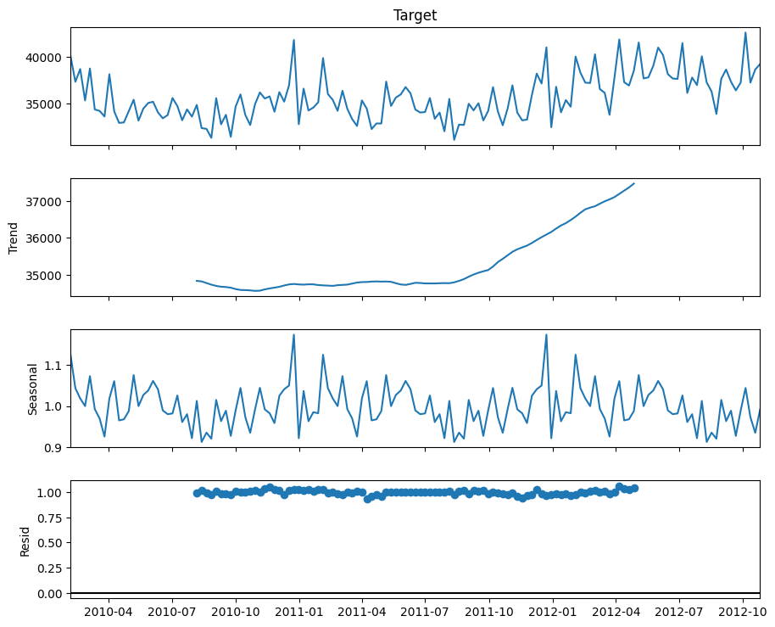
Time Series Analysis

Slide 5
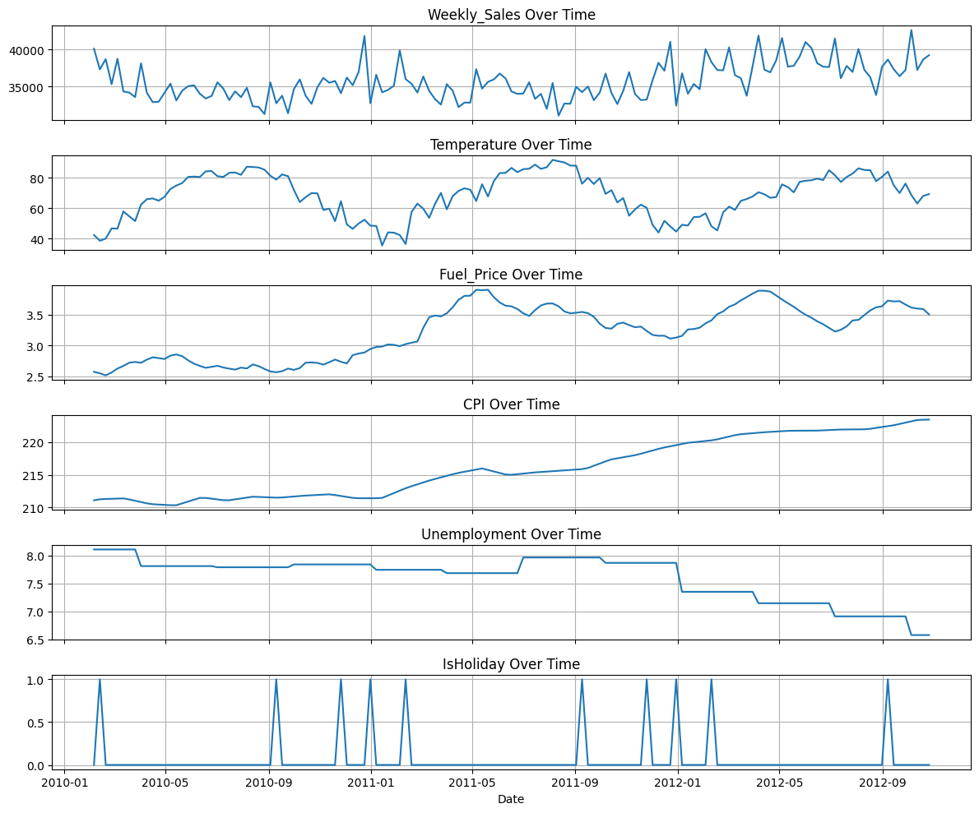

Slide 6
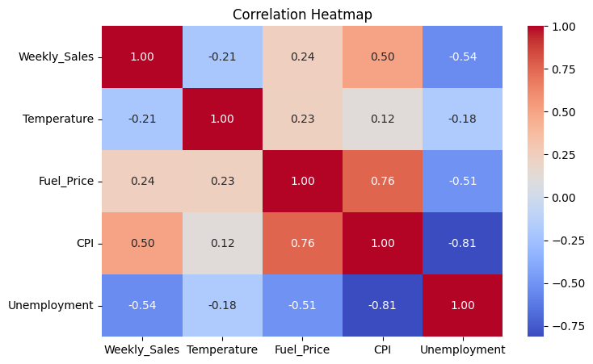

Slide 7
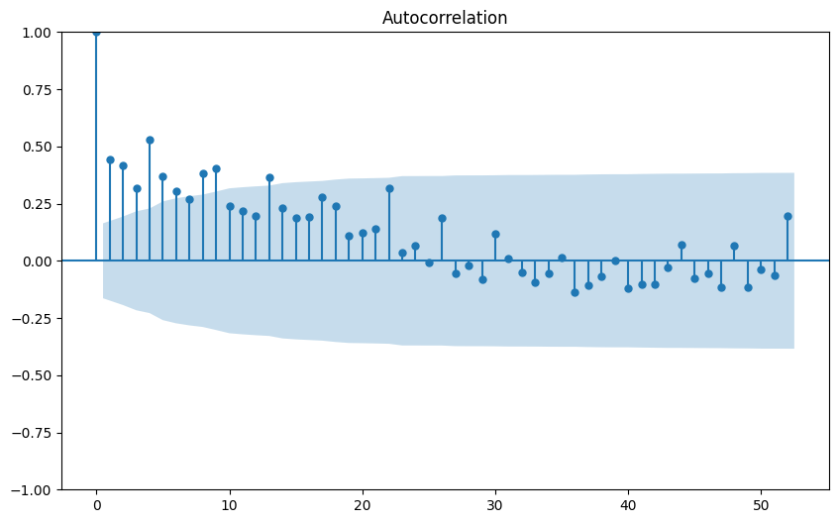
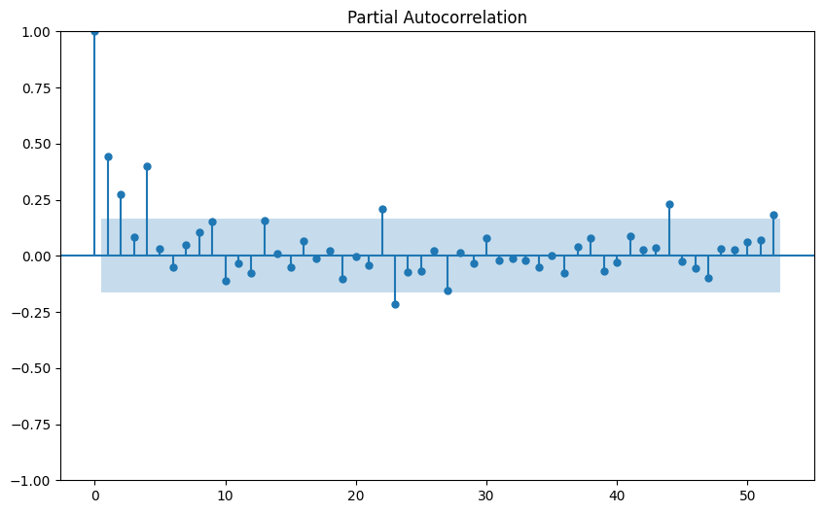

Slide 8
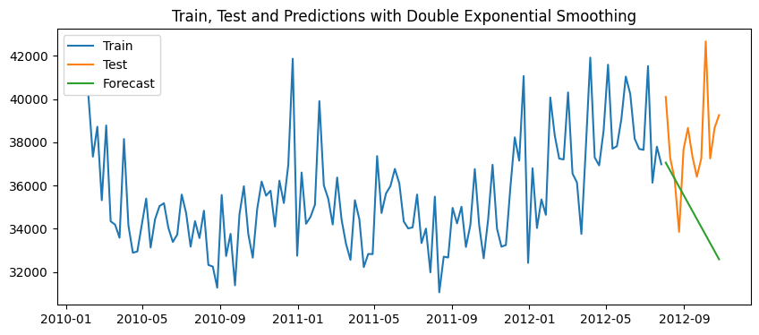
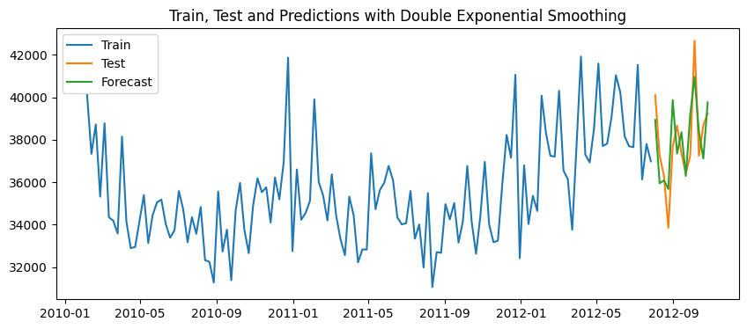
Holt-Winters
Trend only
The MAPE is 8.76 %
The MAPE is 3.24 %
Production
3K+
Trend and Seosonality
80K
Advertising
Others Thing

Slide 9
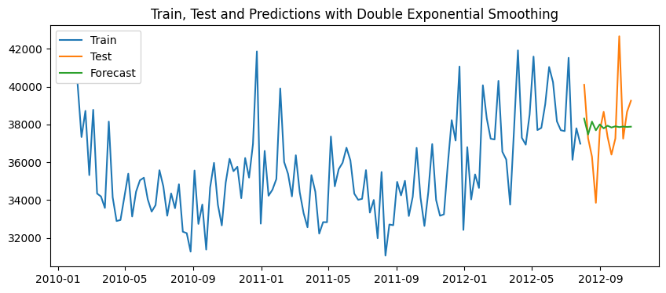
ARIMA, SARIMA, SARIMAX.
ARIMA
The MAPE is 3.88 %

Slide 10

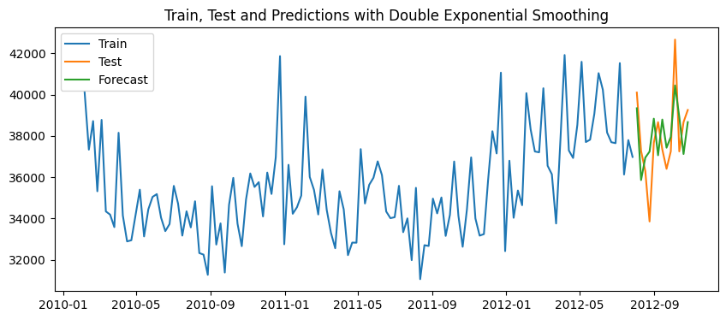
SARIMA
The MAPE is 3.51 %
SARIMAX
The MAPE is 3.73 %

Slide 11
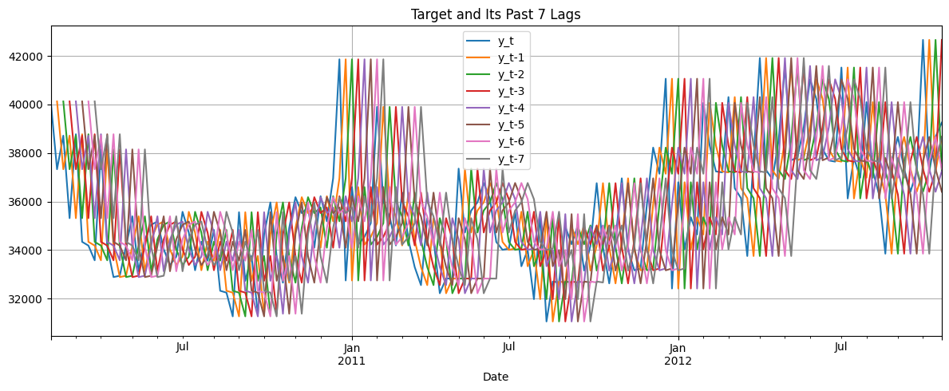
Machine Learning Models
7 lags according to PACF

Slide 12
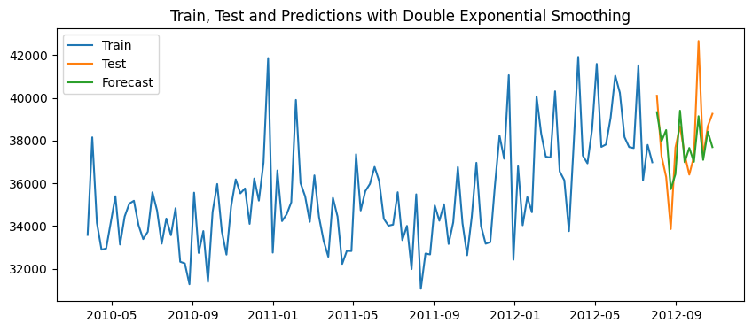
Random Forest
The MAPE is 3.00 %
Best Model

Slide 13

XGBoost
The MAPE is 3.73 %

Slide 14
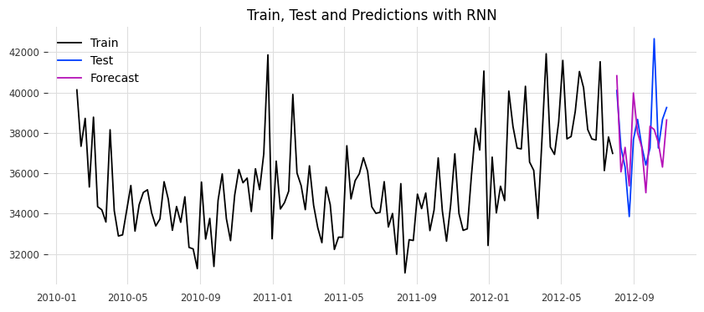
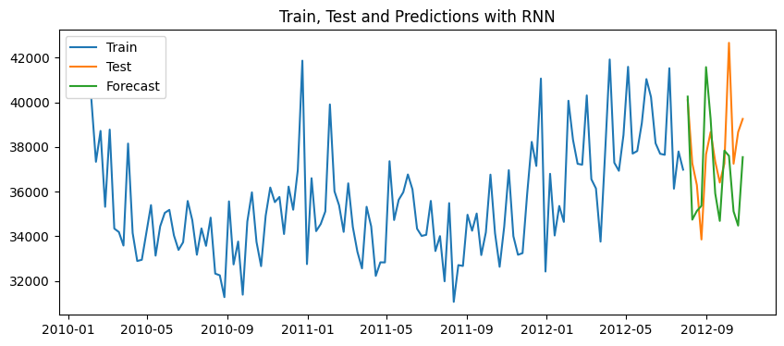
Deep Learning Models
RNN
The MAPE is 3.52 %
CNN
The MAPE is 5.35 %

Slide 15
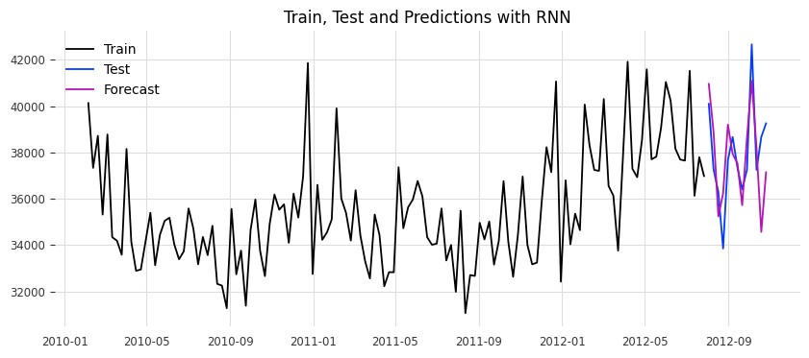
ANN
The MAPE is 3.90 %
keyboard_arrow_down

Slide 16
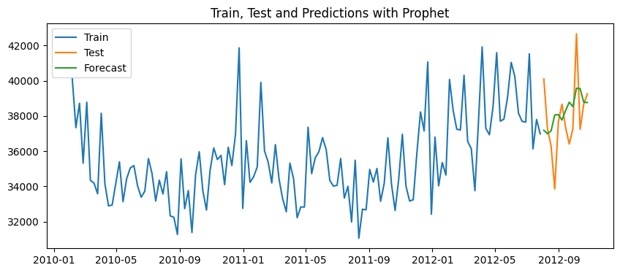
Prophet Forecasting
Best Params:
'changepoint_prior_scale': 0.5, 'seasonality_prior_scale': 10, 'holidays_prior_scale': 10, 'seasonality_mode': 'multiplicative'
Lowest RMSE: 1980.51The MAPE is 4.13 %

Slide 17
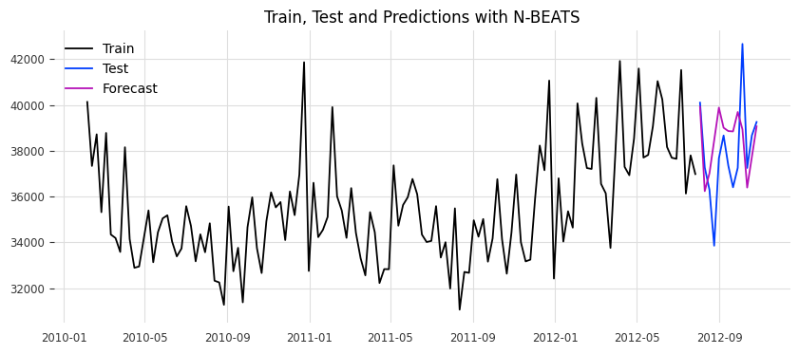
N-BEATS
The MAPE is 4.37 %

Slide 18
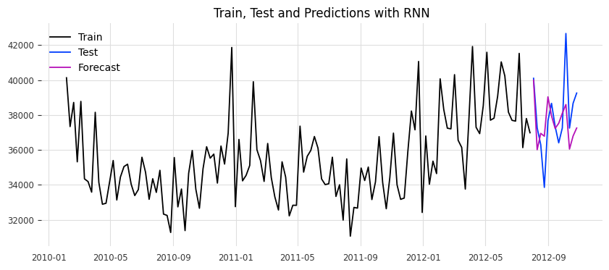

Multi-step RNN
The MAPE is 3.69 %
Multi-Output RNN
The MAPE is 3.62 %

Slide 19
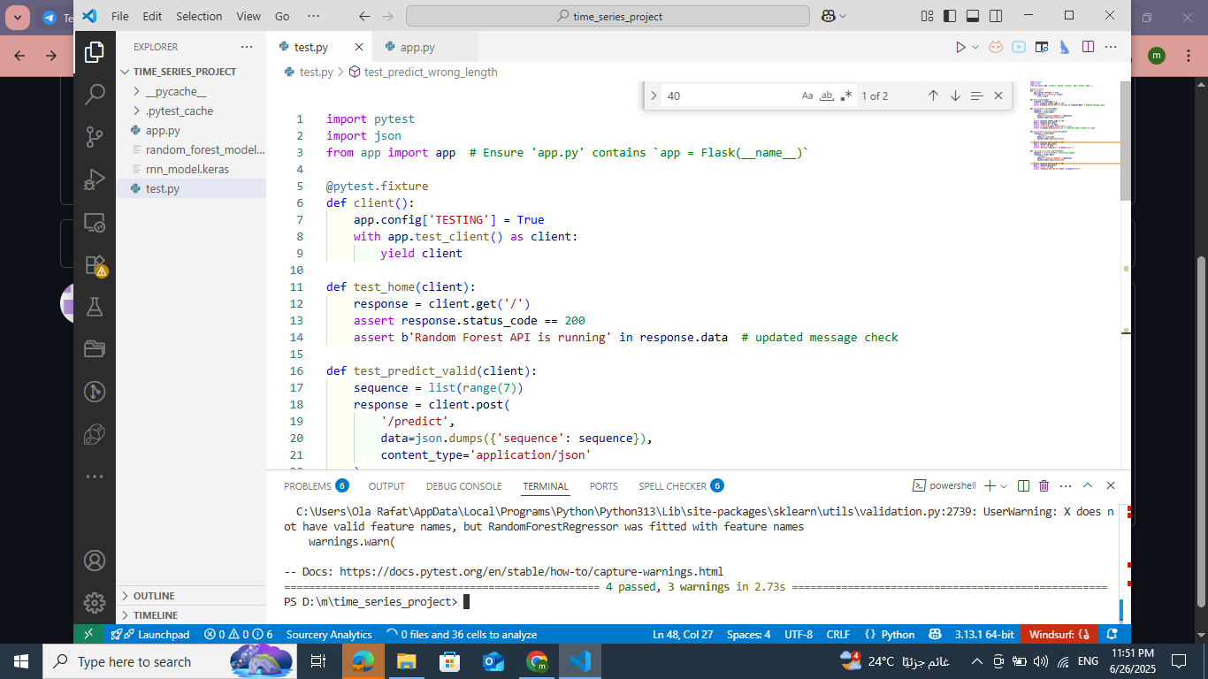
Deployment

Slide 20
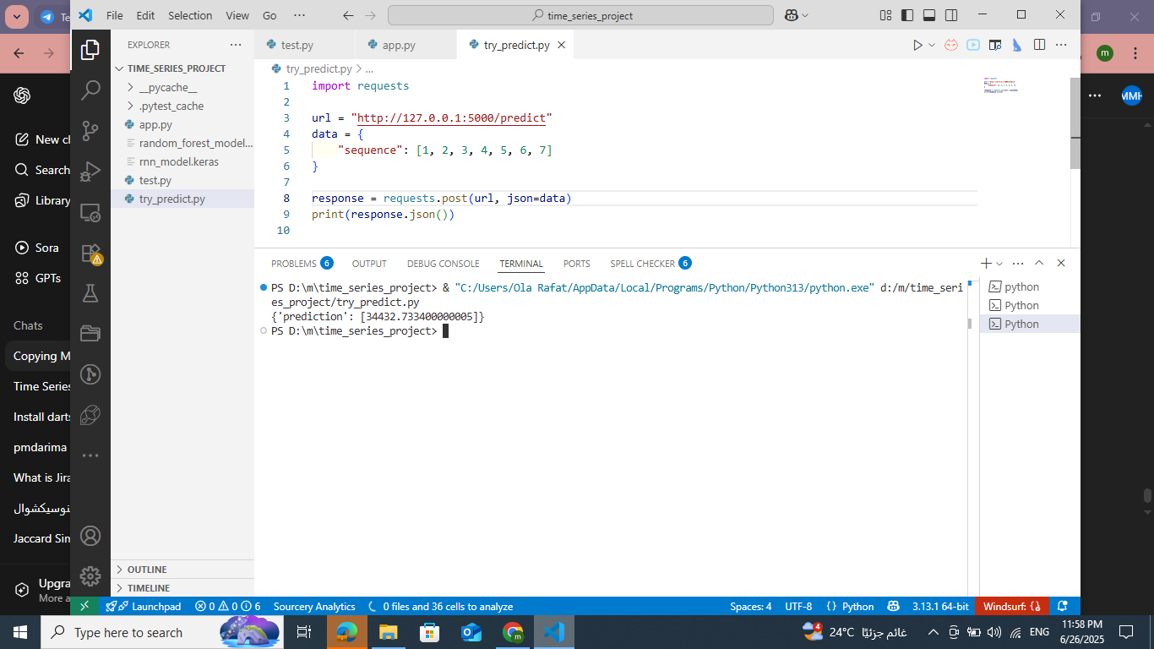

Slide 21
THANK YOU
For Your Attention

